Slide 1

IBM HR Analytics Employee Attrition & Performance
Project Owner :- Sejal Nandanwar(CS22005)
Priya Mankar(CS22011)
Shweta Rewatkar(CS22032)

Slide 2
TABLE OF CONTENTS
Introduction
Background and Problem of the Project
Project Scope
Vision of project & What it aims for
Goal’s And KPI
Goals and Key Performance Indicator
Analysis
Analysis of data and Visualization of Insights
Conclusion
Summary of Entire Case Study Project

Slide 3
INTRODUCTION
BACKGROUND:- We have data of IBM Company , Which is consist of 1470 rows and 33 columns. In which age of employee, daily hour, monthly hour , salary ,salary hike and attrition, gender , married status is given. It is basically consist of current status of IBM Company . Before visualization we analyse the data properly the drive the insights from data which will help us to find out what are steps we should take to minimize the attrition rate.
PROBLEM:-The IBM Company has been experiencing the attrition issue in there company, which is impacting there value in the market and company also losing its performance, to address this issue, it is very essential know the reasons behind attrition and find out insights to attract new employees and for existing employees too

Slide 4
PROJECT SCOPE
The Project start by analysing the provided data, We removed the unnecessary columns and understand the data properly .We Find out the insights behind Attrition rate and how they affect the performance of IBM.
Our analysis will focus on understanding the factors which is responsible for attrition, we mostly focus on the columns like job satisfaction, job role, working environment, years with current manager, over time, department, age, gender and Marital Status of Employee.
The project will identify about what are the reason behind employee attrition , what are the main factors affecting the employee and what will the solution for the improve the performance of the IBM.

Slide 5
GOALS AND KPI’S
1.Data Quality Score.
2. New Employee Acquisition Rate.
3. Attrition Rate
4.Retension Rate
5.Average performance of Company
6. Employee job satisfaction
1.Insure Data Accuracy
2.Understand Customers Need
3. Identify attrition drive
4.Monitor Attrition Rate
5.Improve Customer Satisfaction
6.Develop Retention Strategies

Slide 6
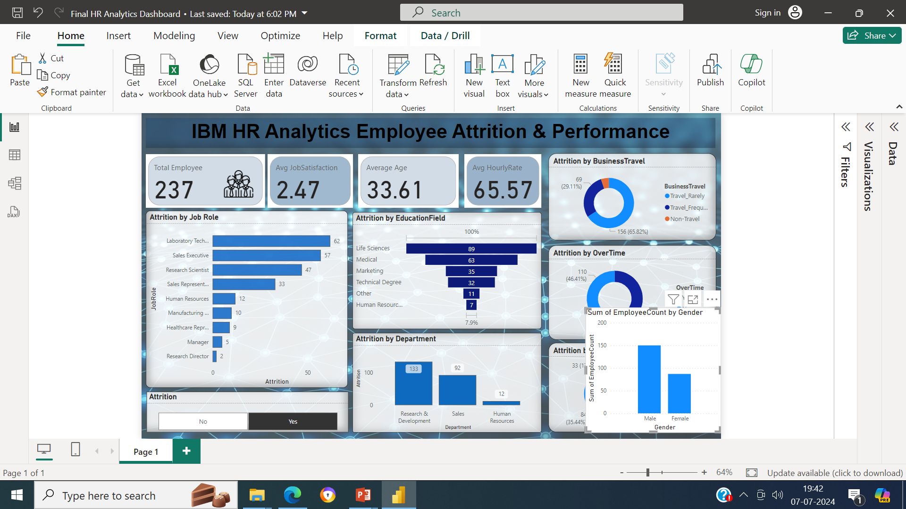
RECOMMENDED ANALYSIS
1.The Attrition Rate is 16.14%.
2.Out of total employee ,237 faced attrition.
3.The average job satisfaction is 2.47.
4.The average age is 37.
5.The average hourly Rate of employee which are facing attrition is 65.89 .

Slide 7
ANALYSIS
In which department attrition level is high?
In which job role attrition rate is high?
Which Education field is have more attrition rate?

Slide 8
ANALYSIS
Is Company loosing high value Employee? If so,then what are the reasons behind Attrition?
Total employee Count in the IBM is 1470 and out of this 237 employee faced attrition. It means 16.14% Attrition Rate is there, So yes we loosing high value employees.
We get form Analysis that research and management department’s Employee faced attrition, So we can retain them by increasing there salary hike or by appreciating them for there good work.
We must know there job satisfaction need And Is there difficulty they faced while working in office environment . This factors may help to know the reason behind the attrition

Slide 9
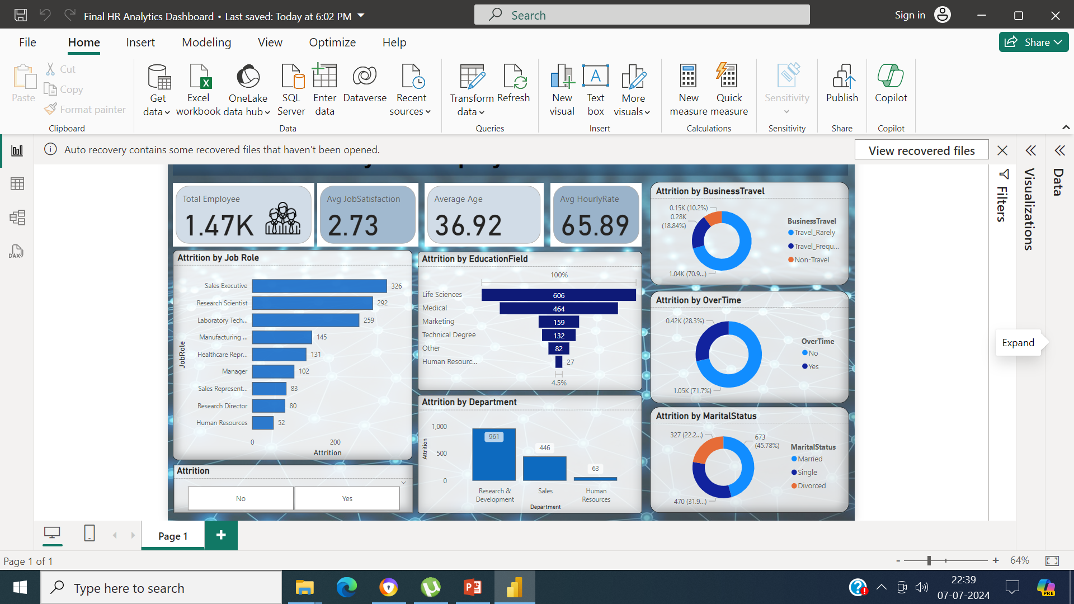
ANALYSIS
1.In Which Category of Marital Status Attrition rate is High?
2.Is Over Time affect attrition rate?
3.What is attrition rate in Business Travel?

Slide 10
CONCLUSION
We want to conclude that,
The attrition rate IBM is 16.14%.
The attrition is high in Research and development department
After analyzation we can say that, attrition rate is high when employee is Single it means juniors faced more attrition.
Most of the employee have high over time which is also reason of attrition.
Job satisfaction and working environment is one the reason .

Slide 11


